Slide 1

Master 2 PIE
Electrical Actuators Courses
Guillaume Krebs
guillaume.krebs@universite-paris-saclay.fr
2026-2027

Slide 2
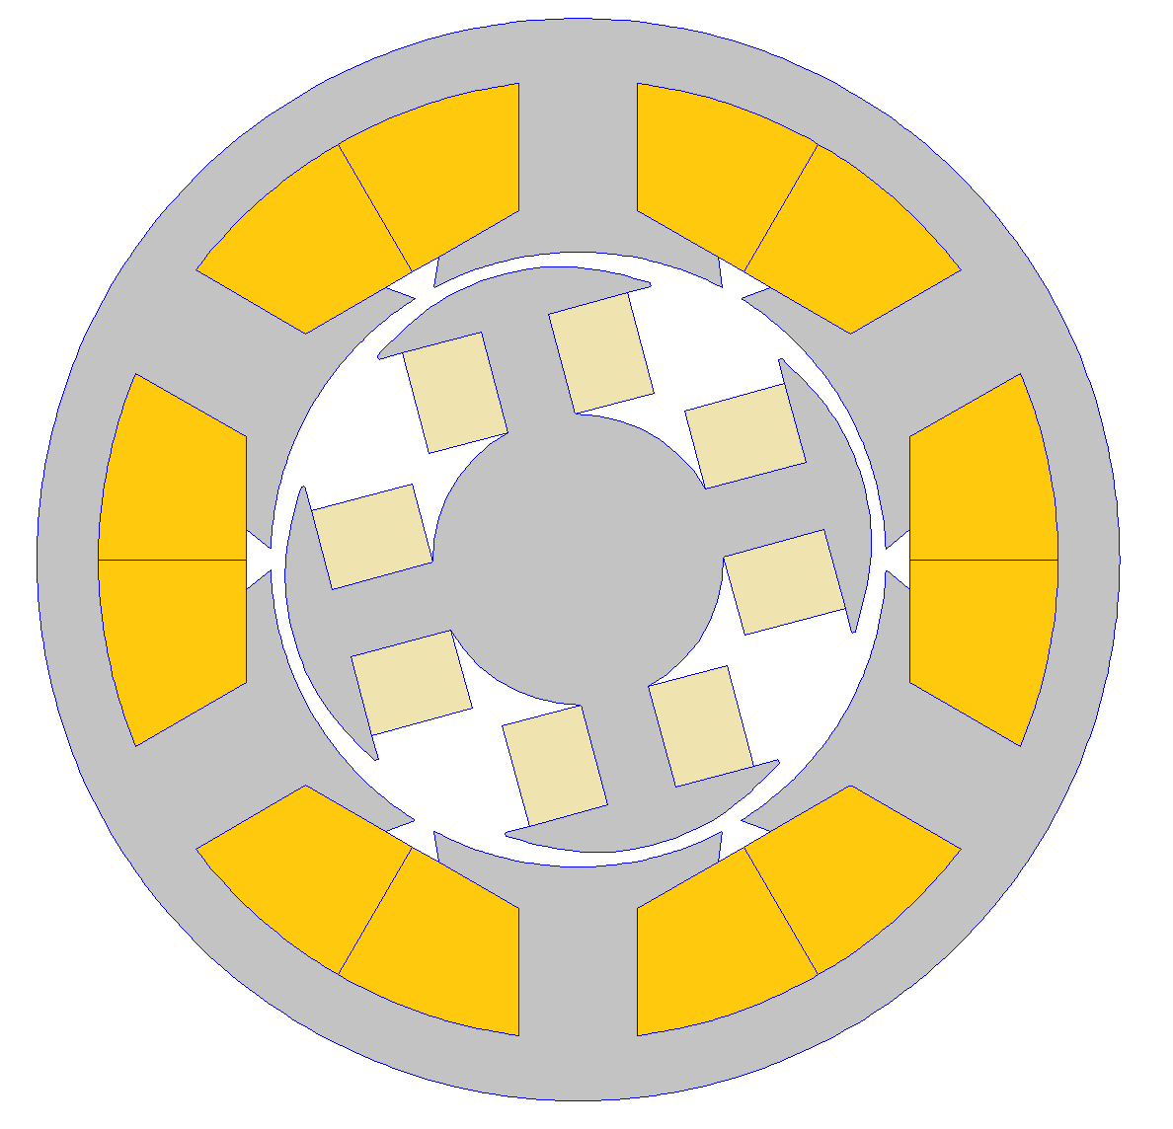
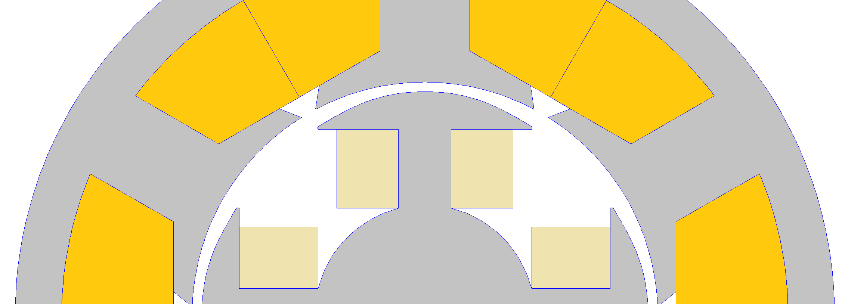
Study of a synchronous motor with a wound rotor
Outer radius of the stator | 44 mm
Inner radius of the stator | 25 mm
Angle α_{r} | 30°
Angle α_{es} | 4°
Active length | 52 mm
Relative permeability of the steel µ_{r} | ∞
Number of turns of a stator coil (coils are in series) | 90
Number of turns of a rotor coil | 30
A+
A-
C-
B+
α_{r}
α_{es}
C+
B-
θ_{m}
rotor
B-
C+
B+
C-
A-
A+
2026-2027

Slide 3
Study of a synchronous motor with a wound rotor
Number of pole pairs of the motor ?
Components of the magnetic torque produced by this motor ?
Comment the geometry drawn under FEMM
Estimate resistance of one phase ( with current density equal to 5A/mm²)
2026-2027

Slide 4
Study of a synchronous motor with a wound rotor
At no load working :
  Supply only the coils in the rotor (I_{r} = 1 A)
  Observe and comment the magnetic flux density
  Compute and verify with Femm the magnetic flux density where the airgap is the smaller
  Discuss about the pitch factor
  Use the script move_rotor and observe the stator flux linkages
  Determine the harmonic contain of the stator fluxes (why the third harmonic is null ?)
  Compute the no load EMFs induced at a speed of 1500 rpm
  Determine the harmonic contain of the EMFs and comment
  Comment the shape of the no-load torque (period, no-load value), try to improve the curve
  Compute the airgap permeance density
2026-2027

Slide 5
Study of a synchronous motor with a wound rotor
Script for Femm
openfemm(1);
opendocument('MSRB_calcul.FEM');
mi_saveas('temp.fem');
angle=0;
pas=1;
alfa=27;
for k=1:1:180
mi_modifyboundprop('move',10,angle);
Ia= xxx;
Ib=xxx;
Ic=xxx;
Irot=4;
mi_modifycircprop('Ia',1,Ia);
    mi_modifycircprop('Ib',1,Ib);
    mi_modifycircprop('Ic',1,Ic);
mi_modifycircprop('Irot',1,Irot);
mi_analyze(1);
    mi_loadsolution();
mo_seteditmode('area');
    mo_groupselectblock(2);
    c=mo_blockintegral(22);
    couple(k)=c;
    mo_clearblock();
    res_bob(1:3)=mo_getcircuitproperties('Ia');
    flux(k,1)=res_bob(3);
    res_bob(1:3)=mo_getcircuitproperties('Ib');
    flux(k,2)=res_bob(3);
    res_bob(1:3)=mo_getcircuitproperties('Ic');
    flux(k,3)=res_bob(3);
    res_bob(1:3)=mo_getcircuitproperties('Irot');
    flux(k,4)=res_bob(3);
    mo_seteditmode('area');
    mo_groupselectblock(2);
    mo_groupselectblock(0);
mo_close;
angle=angle+pas;
position(k)=angle;
end
mi_close;
closefemm;
couple_moy=mean(couple);
2026-2027

Slide 6
Study of a synchronous motor with a wound rotor
Self and mutual inductances :
  Impose I_{r} = 0 A and I_{A} = 1 A , then compute all the flux linkages and deduce inductances
  Comment the curves computed in terms of amplitudes, average values, and period
  Impose I_{r} = 1 A and I_{A} = 0 A , then compute all the flux linkages and deduce inductances
  Assuming sinusoidal variations of the inductances, give their expressions
  Comment the two following variables : “mechanical angle” and “electrical angle”
2026-2027

Slide 7
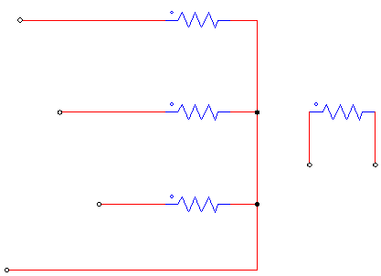
Study of a synchronous motor with a wound rotor
Flux :
  Give the expressions of the fluxes Φ_{A}, Φ_{B}, Φ_{C}, Φ_{R} depending on self and mutual inductances and also currents.
Magnetic energy and torque :
  Give the expression of the magnetic energy depending on self and mutual inductances
  Give the four components of the torque
i_{A}
L_{A}
i_{A}
L_{A}
M_{AR}
M_{AR}
M_{AC}
M_{AB}
M_{AC}
M_{AB}
L_{B}
M_{BR}
L_{R}
i_{B}
L_{B}
M_{BR}
i_{B}
L_{R}
v_{A}
M_{BC}
I_{R}
v_{A}
M_{BC}
I_{R}
v_{B}
i_{C}
L_{C}
V_{R}
V_{R}
v_{B}
i_{C}
L_{C}
M_{CR}
M_{CR}
v_{C}
N
v_{C}
N
2026-2027

Slide 8
Study of a synchronous motor with a wound rotor
Comparisons of the torque components
clear all;
%************************ Variables
syms La syms teta Ia I phi
%******************** Phase A only powered
load flux_abc_A; %from Femm
temp=max(size(flux));
L0= xxx;
L1=xxx;
aL1a=xxx;
%************************ Inductances
La=L0+L1*cos(xxx*teta+aL1a);
%************************ Current
Ia=I*sin(xxx*teta-phi);
%************************ Torque
CL=0.5*diff(La,teta)*Ia^2;
%******************** Torque depending on teta and current phase shift
for j=1:1:90
  teta=0:2*pi/1000:2*pi;
  phi=(j-1)*pi/180;
  I=4;
  torque=eval(CL);
  torque_average(j)=mean(torque);
  Iphi(j)=phi*180/pi;
end
%************************ Curve
figure
plot(Iphi, torque_average)
xlabel('phi (°)')
ylabel('Torque (N.m)')
title('torque')
grid on
  - Modifiy the following program for having the four
  torque components
  - Verify the maximum torque values with Femm
2026-2027

